Slide 1

Fundamental Banking System
Team : Tech Coders
Prof. Do Hyunsook
BANK

Slide 2

About...
Internal Banking System
Web Application
Roles
Cashier
Manager

Slide 3
Functionalities
Customer Management
Account Management
Data Security
Home Page
Login Page
Cashier Services

Slide 4

Cashier functionalities
Deposit
Withdraw
Transfer
Mini Statement

Slide 5

Technologies used..
Languages: HTML, CSS, Javascript, JQuery, C#
Framework: MVC
Database: SQL Server
Tools: MS Visual studio, Git Hub, Trello

Slide 6
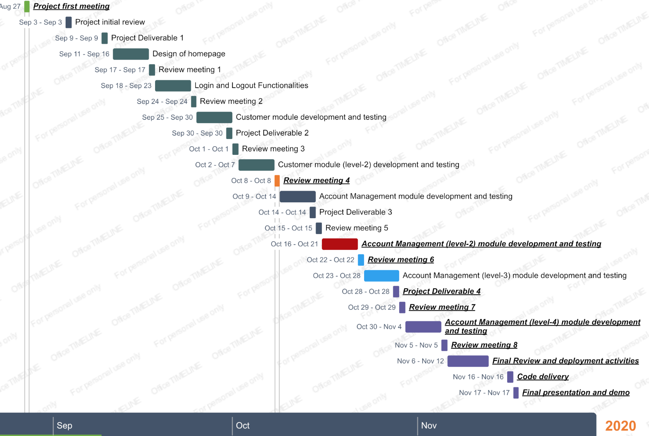
Project Timeline..

Slide 7
Roles and Responsibilities…
Team Member | Role
Vishnu theja | Database Administrator, Testing, Documentation
Rushi Savulge | UI/UX Developer, Testing, Documentation
Gunavardhan | UI/UX Developer, Testing, Documentation
Akhil Totakura | C# Developer, Testing, Documentation
Sagar Tulluru | C# Developer, Testing, Documentation

Slide 8
Risk Management..
1) Application Security:
Restricting Unauthorized access, Encrypting the DB connection string, Encrypting the passwords in the login.
2) Unexpected Exceptions:
We will deal the unexpected exception by implementing Exception Handling (try, catch and finally blocks) for every functionality.
3) Database Inconsistencies:
These Inconsistencies may happen due to DB connection issues or any mismatch between the DB structure and application code. These can be avoided by proper planning while creating DB and Integration of DB to application.

Slide 9
Questions..?
Notes:
You can safely remove this slide. This slide design was provided by SlideModel.com – You can download more templates, shapes and elements for PowerPoint from http://slidemodel.com

Slide 10
Thank You
Notes:
You can safely remove this slide. This slide design was provided by SlideModel.com – You can download more templates, shapes and elements for PowerPoint from http://slidemodel.com

